Slide 1
Kanban the Agile Process

Slide 2
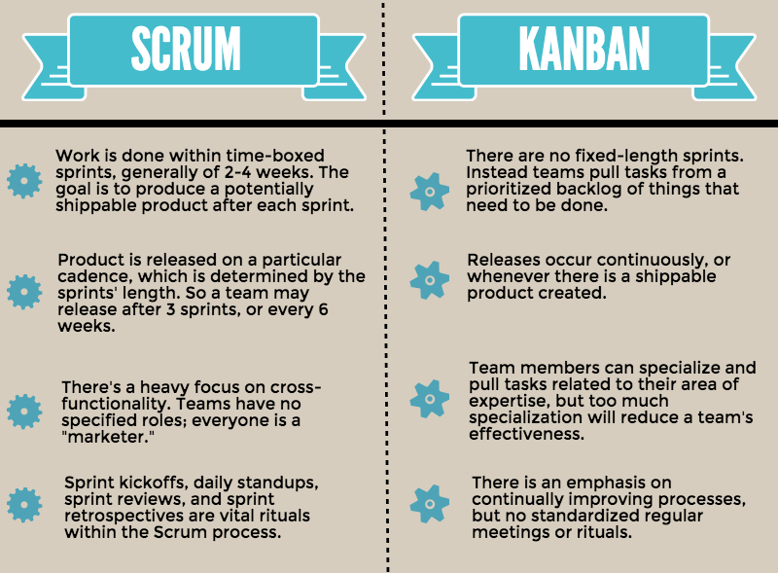
https://www.workfront.com/sites/default/files/imported/333498063-27283.png

Slide 3
Reference
What is Kanban? The Ultimate Guide - Learn Kanban Now! (natthompson.com)

